Slide 1
Microsoft Dynamics AX 2012 Administration Workshop Chapter 11: Microsoft Office Add-Ins and Integration
Presenter Name
Presenter Title
Presenter Company

Slide 2
Conditions and Terms of Use
Microsoft Confidential
This training package is proprietary and confidential, and is intended only for uses described in the training materials. Content and software is provided to you under a Non-Disclosure Agreement and cannot be distributed. Copying or disclosing all or any portion of the content and/or software included in such packages is strictly prohibited.
The contents of this package are for informational and training purposes only and are provided "as is" without warranty of any kind, whether express or implied, including but not limited to the implied warranties of merchantability, fitness for a particular purpose, and non-infringement.
Training package content, including URLs and other Internet Web site references, is subject to change without notice. Because Microsoft must respond to changing market conditions, the content should not be interpreted to be a commitment on the part of Microsoft, and Microsoft cannot guarantee the accuracy of any information presented after the date of publication. Unless otherwise noted, the companies, organizations, products, domain names, e-mail addresses, logos, people, places, and events depicted herein are fictitious, and no association with any real company, organization, product, domain name, e-mail address, logo, person, place, or event is intended or should be inferred.
Copyright and Trademarks
© 2013 Microsoft Corporation. All rights reserved.
Microsoft may have patents, patent applications, trademarks, copyrights, or other intellectual property rights covering subject matter in this document. Except as expressly provided in written license agreement from Microsoft, the furnishing of this document does not give you any license to these patents, trademarks, copyrights, or other intellectual property.
Complying with all applicable copyright laws is the responsibility of the user. Without limiting the rights under copyright, no part of this document may be reproduced, stored in or introduced into a retrieval system, or transmitted in any form or by any means (electronic, mechanical, photocopying, recording, or otherwise), or for any purpose, without the express written permission of Microsoft Corporation.
For more information, see Use of Microsoft Copyrighted Content at http://www.microsoft.com/about/legal/permissions/
Microsoft®, Excel®, Microsoft Dynamics®, and Windows® are either registered trademarks or trademarks of Microsoft Corporation in the United States and/or other countries. Other Microsoft products mentioned herein may be either registered trademarks or trademarks of Microsoft Corporation in the United States and/or other countries. All other trademarks are property of their respective owners.

Slide 3
Students: How to View this Presentation
Switch to Notes Page view
Click View on the ribbon and select Notes Page
Use page up or page down to navigate
Zoom in or out as needed
Most slides will have supporting text that you can view now or after the delivery
Add notes to your copy of the presentation if you want to
You take the presentation files home with you.
Notes:
If this presentation is intended for a Workshop, this slide and the subsequent slide will need to remain in the PPT

Slide 4
Objective
After completing this chapter, you will be able to:
Install Microsoft Office Add-ins.
Configure the Remote Desktop Services integration.
Enable data to be accessed from Microsoft Office Word and Excel.
Pull data into an Excel refreshable report.

Slide 5
Introduction
Using Office Add-ins
Lightweight reporting: Export from any grid in the client or Enterprise Portal.
Templates and documents: Integrate Microsoft Dynamics AX data in Word or Excel documents (collection letters and quotations, for example)
Editing data in Excel: Update Microsoft Dynamics AX data by using the Excel add-ins.
Import data by using Excel: Excel can be used as a template to collect reference and master data to be imported into Microsoft Dynamics AX.
Remote Desktop Services Integration
Enables integration with a local installation of Office when running Microsoft Dynamics AX client on a Remote Desktop server.
Notes:
You can use Microsoft Office Add-ins for Microsoft Dynamics AX to integrate the Microsoft Dynamics AX client with Excel or Word.
When you install the Microsoft Office Add-ins, a new Microsoft Dynamics AX contextual tab is created on the ribbon in Excel and Word. You can use the controls on this tab to create and refresh data in an Excel spreadsheet or a Word document.
Business users who use Microsoft Office Add-ins for Microsoft Dynamics AX 2012 can interact with data in Microsoft Dynamics AX 2012. The Microsoft Office Add-ins lets a user export and import data.
The Microsoft Dynamics Add-ins for Microsoft Office, enable queries and AIF Document services to be integrated into documents built with Word or Excel. Microsoft Office Add-ins connects directly to the Application Object Server (AOS) using WCF-based web services.
The four main uses for the Microsoft Add-ins include:
Lightweight reporting: From any grid in the client or Enterprise Portal, export data, extend and build upon it in Excel, then refresh as conditions change.
Templates and documents: Incorporate Microsoft Dynamics AX 2012 data in Word or Excel documents (for example: collection letter, quotation, sales forecast, project forecast, aging report, and so on).
Editing data in Excel: Update Microsoft Dynamics AX 2012 data by using the Excel add-ins.
Import data by using Excel: Excel can be used as a template to collect reference and master data to be imported into Microsoft Dynamics AX 2012.
The Remote Desktop Services integration components for Microsoft Dynamics AX support integration with local applications, such as Word and Excel, when Microsoft Dynamics AX is hosted on a Remote Desktop server.

Slide 6


Install Office Add-Ins
Install from Microsoft Dynamics AX Setup.
Select Office add-ins. It will also automatically select Remote Desktop Services integration.
Notes:
Procedure: Install Office Add-Ins
Use this procedure to install the Microsoft Office Add-ins files.
Start Microsoft Dynamics AX Setup. Under Install, select Microsoft Dynamics AX components.
Click Next on the Welcome page.
Click Add or modify components, and then click Next.
Select Office add-ins. It will also automatically select Remote Desktop Services integration and click Next.
Install prerequisite requirements, and then click Next.
On the Ready to install page, click Install.
Exit the wizard.

Slide 7
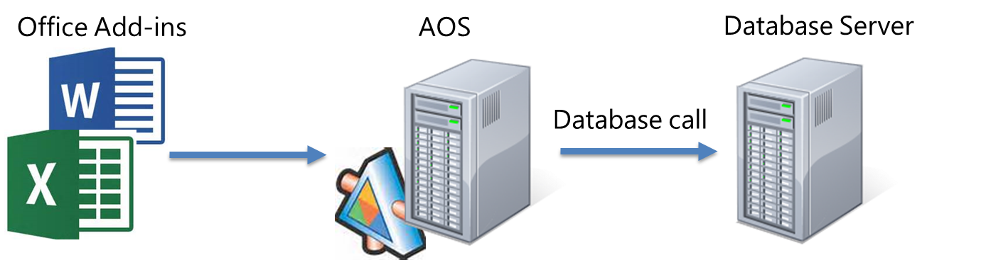
Office Add-Ins
Uses Windows Communication Foundation (WCF) services to connect
Can only use explicitly enabled data sources
Uses Windows credentials of currently logged on user
Role-based security and XDS policies apply

Slide 8
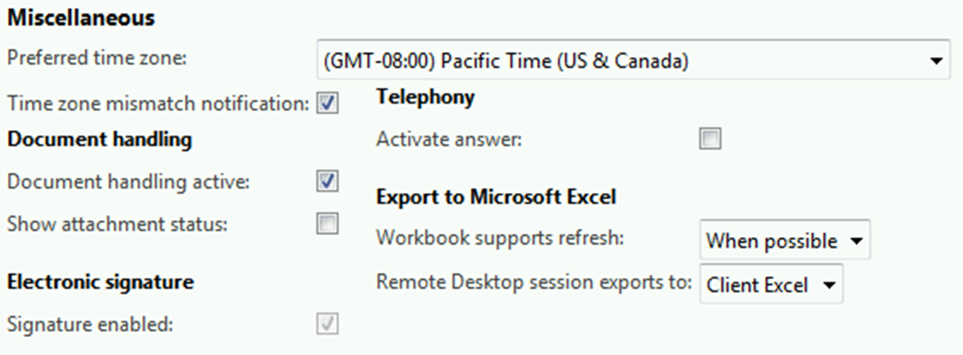
Configure Excel Options
File > Tools > Options > General > Miscellaneous > Export to Microsoft Excel

Slide 9
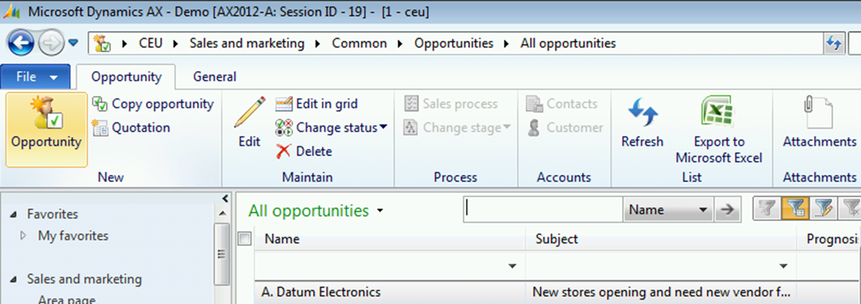
Export to Excel
File > Tools > Options > General > Miscellaneous > Export to Microsoft Excel List
Notes:
From any grid in the client or Enterprise Portal, export data, extend and build upon it in Excel, then refresh as conditions change.

Slide 10
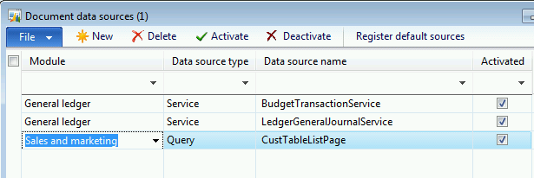
Enable Document Data Sources
Organization administration > Setup > Document management > Document data sources
Notes:
Excel can only see document data sources activated in the Document data sources screen.
A Query data source is read only.
A Service data source can be read/write.

Slide 11
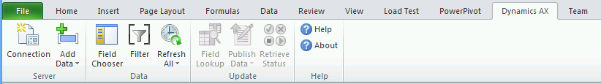
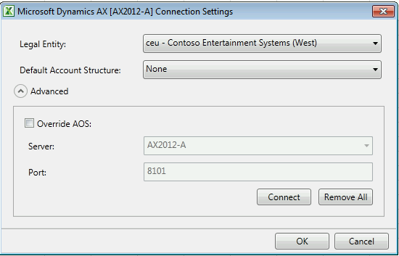
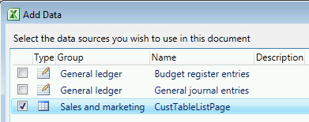
Query Data from Excel
Excel > Dynamics AX tab > Add Data
Query
Grid icon
Services
Icon with pencil
Notes:
Use the connection properties to configure:
The Legal Entity and default account structure to be used.
The AOS service for the connection.
Use Add Data to select from a list of activated document data sources.

Slide 12
Configure Excel Options
Scenario:
You want users to be able to export data to their local copy of Office when running Microsoft Dynamics AX through Remote Desktop Services. You also want to make sure they can refresh the data through Excel, on demand.
Procedure:
Microsoft Dynamics AX Client > File > Tools > Options > General >Miscellaneous > Export to Microsoft Excel
Notes:
Procedure: Configure Excel Options
Use this procedure to configure the Export to Microsoft Excel options for a user:
From the Microsoft Dynamics AX client, go to File > Tools > Options > General and scroll down to the Miscellaneous section and review the Export to Microsoft Excel options.
For the Remote Desktop session exports to option, select Client Excel.
For the Workbook supports refresh option, select When Possible, and then click Close.

Slide 13
Export to Excel from the Microsoft Dynamics AX Client
Scenario:
You would like to create a custom refreshable Excel spreadsheet to easily report on the status of customer opportunities. You would like to create the report based on a list page in the Microsoft Dynamics AX client.
Procedure:
Microsoft Dynamics AX Client > Sales and Marketing > Common > Opportunities > All Opportunities > Export to Microsoft Excel
Notes:
Procedure: Export to Excel from the Microsoft Dynamics AX Client
To create an Excel spreadsheet based on the Opportunities list page that can be refreshed later as business data changes, follow these steps:
Use the status bar (lower right corner of the Microsoft Dynamics AX client) to change companies to CEU if you’re not already in that company.
Go to Sales and Marketing > Common > Opportunities > All Opportunities.
Click Export to Microsoft Excel. Notice the information from the list page now shows up in a new Excel spreadsheet.
At the top of the workbook, click the Dynamics AX tab to show the Microsoft Dynamics AX ribbon.
Click Field Chooser to show the available fields on the left of the screen.
Select and drag Estimated revenue from the Field Chooser to the spreadsheet.
Click Field Chooser to close the Field Chooser.
Click Refresh All to refresh your data from Microsoft Dynamics AX. The Field Chooser must be closed to activate the Refresh All button.

Slide 14
Query Microsoft Dynamics AX data from Excel
Scenario:
You would like to create a custom refreshable Excel spreadsheet that contains customer data. You want the data to be based on a custom Microsoft Dynamics AX query.
Procedure:
Organization administration > Setup > Document management > Document data sources
Excel > Dynamics AX tab > Add Data
Notes:
Procedure: Query Microsoft Dynamics AX Data from Excel
To create an Excel spreadsheet based on a query that can be refreshed later as business data changes, follow these steps:
From a Microsoft Dynamics AX client, go to Organization Administration > Setup > Document management > Document data sources.
Click New to add a new data source. Select Sales and marketing as the Module, Query as the Data source type, and CustTableListPage as the Data source name. Select the Activated check box, and then close the form.
Open Microsoft Excel and click the Dynamics AX tab at the top to open the Microsoft Dynamics AX ribbon.
Click Connection and select CEU as the Legal Entity. Click OK.
Click Add Data to browse the available data sources. The data sources with a pencil icon are Microsoft Dynamics AX web services that have been configured to work with Microsoft Office Add-ins. The data sources with a grid icon are queries defined in Microsoft Dynamics AX.
Select the CustTableListPage data source from the list and click OK. The Field Chooser will display the tables and fields available in that query.
Right-click the root data source Sales Quotation (the top item in the Field Chooser), select Properties.
Select the Show Calculated Fields option to show the display and edit methods available for this query, click OK.
Drag the following fields onto the worksheet from the Customers table:
Name
Customer Account
Amount (balanceMST)
Click Field Chooser on the Microsoft Dynamics AX ribbon to close the Field Chooser and enable the Refresh All button.
Click Refresh All to populate the worksheet.

Slide 15
Chapter Review
Test your knowledge with the following questions.
The main uses for the Microsoft Office Add-ins include: (Select all that apply.)
( ) Lightweight reporting
( ) Editing data in Excel
( ) Import data using Excel
( ) Templates and documents
(True or False). To use the Microsoft Office Add-ins for Microsoft Dynamics AX, you can only use Office, which is hosted on the Remote Desktop Server if the Remote Desktop Services integration is installed.
( ) True
( ) False

Slide 16
Chapter Review (Answers)
Test your knowledge with the following questions.
The main uses for the Microsoft Office Add-ins include: (Select all that apply.)
(x) Lightweight reporting
(x) Editing data in Excel
(x) Import data using Excel
(x) Templates and documents
(True or False). To use the Microsoft Office Add-ins for Microsoft Dynamics AX, you can only use Office, which is hosted on the Remote Desktop Server if the Remote Desktop Services integration is installed.
( ) True
(x) False

Slide 17
Chapter Summary
In this chapter, we reviewed the following topics:
Installing Office add-ins.
Configuring the Remote Desktop Services integration.
Enabling data to be accessed from Word and Excel.
Pulling data into an Excel refreshable report.

